Slide 1

Introduction to Neural Networks
Advanced Track Workshop #2
ACM AI
Slides: https://tinyurl.com/advtrack-fall19-week4
Notes:
6:00

Slide 2
Resources
ACM AI
Slides: https://tinyurl.com/advtrack-fall19-week4
Membership Portal Code: atrack2

Slide 3
Review Exercise
ACM AI
Linear regression
Logistic regression
What does it mean to say a neural network is “learning”?
Notes:
6:15

Slide 4
Revisiting the Math Behind Gradient Descent
ACM AI

Slide 5
Hypothesis Function
Outputs are a linear representation of the inputs
Single feature
h(x) = w₀ + w₁x
Multiple features
h(x₁...x_{n}) = w₀ + w₁x₁+ w₂x ₂+...+ w_{n}x_{n}
Weights: w
We change the weight parameters in order to come up with the best hypothesis that fits our data
Multiple features
We have n features instead of 1, that means we have n features, one for each x

Slide 6
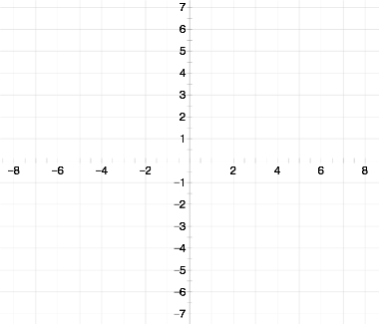
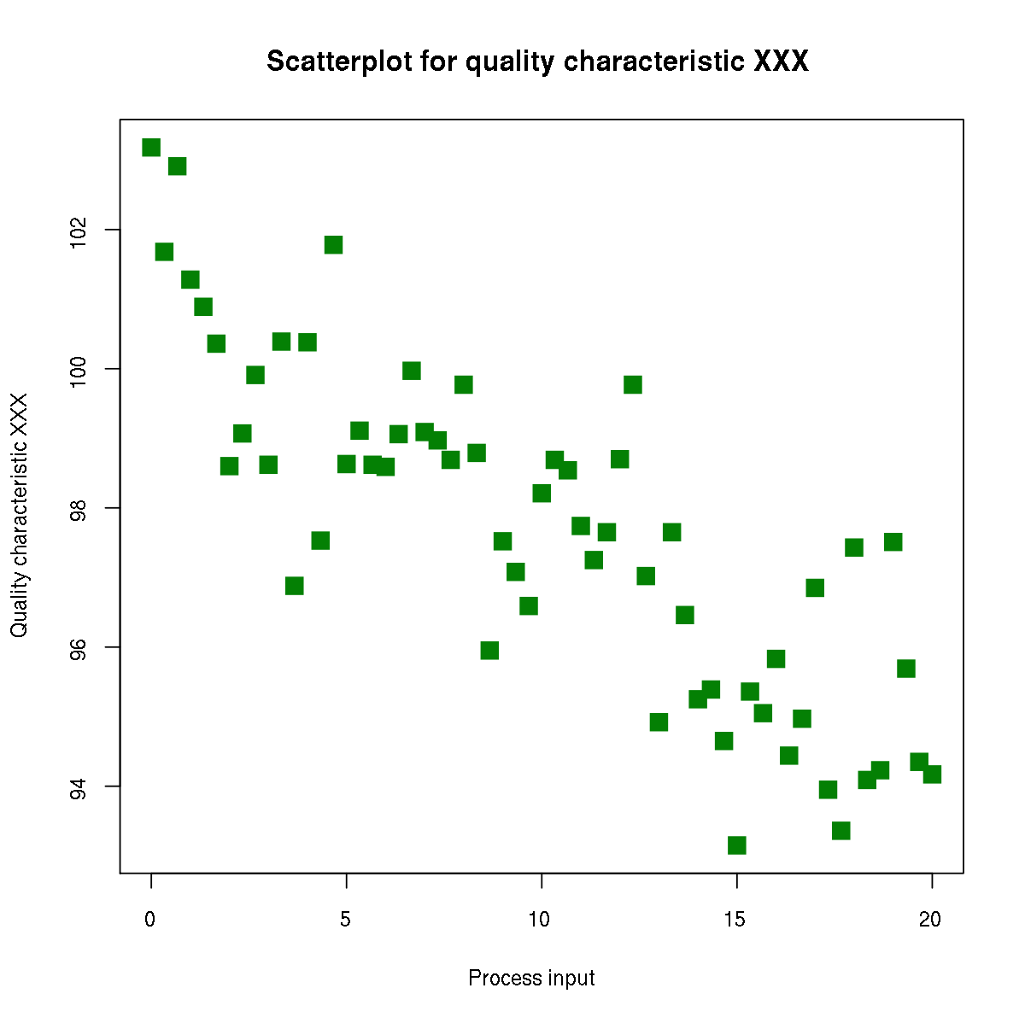
Predicted Value
Actual value
Linear Regression Plot

Slide 7
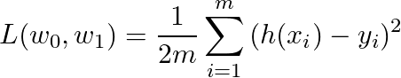
Cost Function
½ of the mean of the squares of the differences between predictions and actual outputs
Mean squared error function
½ is there for convenience when taking derivatives of this formula

Slide 8
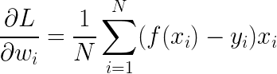
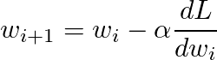
Gradient Descent
Our goal is to minimize the loss by adjusting the values for our weight matrices and bias terms
Intuitively, we want to find out the impact of a particular weight on the overall error.
Adjust the current weights:
Learning rate

Slide 9
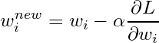
Gradient Descent
Our goal is to minimize the loss by adjusting the values for our weight matrices and bias terms
Intuitively, we want to find out the impact of a particular weight on the overall error.
Adjust the current weights:
Learning rate

Slide 10
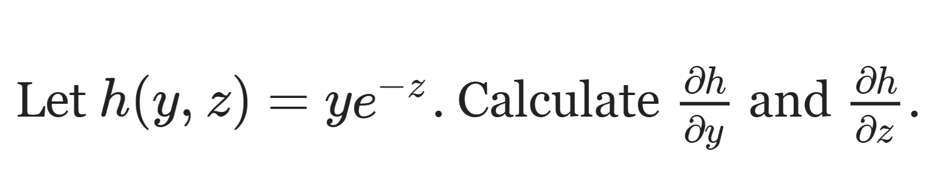
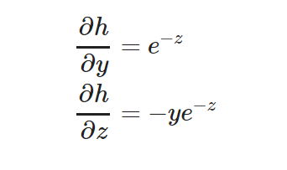
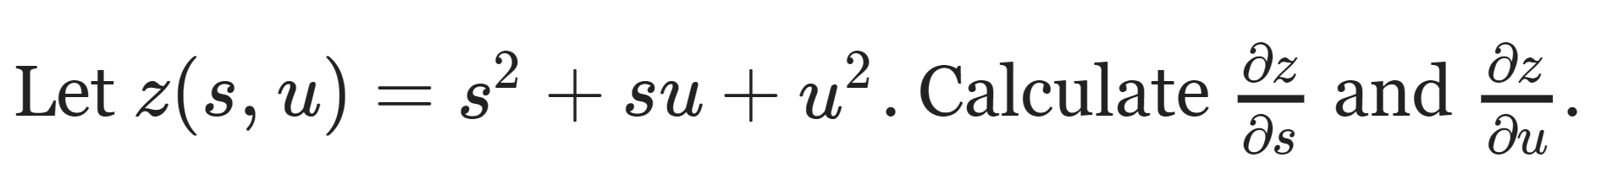
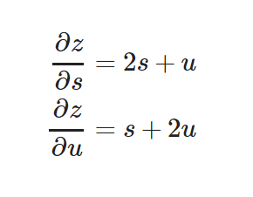
Partial Derivative Exercise

Slide 11

Gradient Descent (cont.)
Iterations of gradient descent continue until the cost function converges to a local minimum

Slide 12
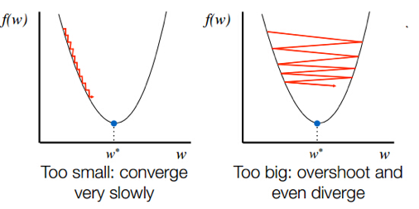
Learning Rate
determines by how much we adjust weights with respect to loss gradient
smaller the learning rate, the slower we converge to cost function minimum
Traditional default: 0.1 or 0.01

Slide 13
2. Neural Networks: Overview
ACM AI
Slides: https://tinyurl.com/advtrack-fall19-week4
Notes:
Beginning with a quick review of the beginner track from spring quarter linear and logistic regression.
People with prior experience might already be familiar, but we want to ease into the workshops.

Slide 14

Neural Networks
ACM AI

Slide 15
Neural Networks Pipeline
ACM AI
Define architecture
Pass inputs forward, get prediction
Compute loss
function of prediction and actual label
Perform gradient descent to get weight adjustments
Propagate adjustments backwards
backpropagation, chain rule for derivatives

Slide 16
History
Long Short-Term Memory Algorithm (LSTM) - 1997
Field driven by experimental findings → need tools to advance
Hardware
High performance graphic chips
Datasets
Algorithmic Advances
Missing reliable way to train

Slide 17
Artificial Neuron
ACM AI
FEATURES
# Bathrooms
# Bedrooms
# Sq. feet
WEIGHTS
Logistic Regression
Weights Vector w
Activation Function σ
Bias b
Recall: Logistic Regression Equation
Y = σ(xw + b)
Y

Slide 18
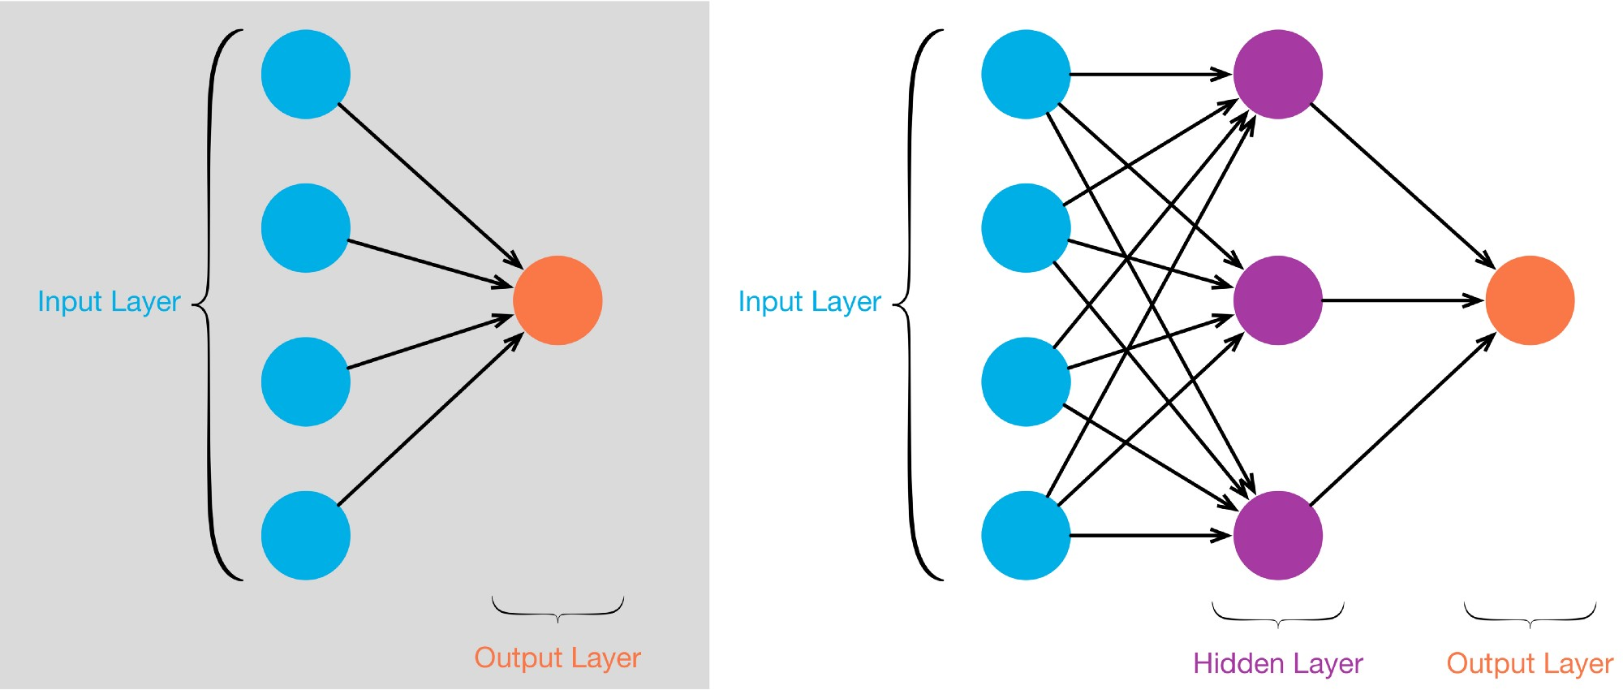
Logistic Regression
Single layer NN

Slide 19
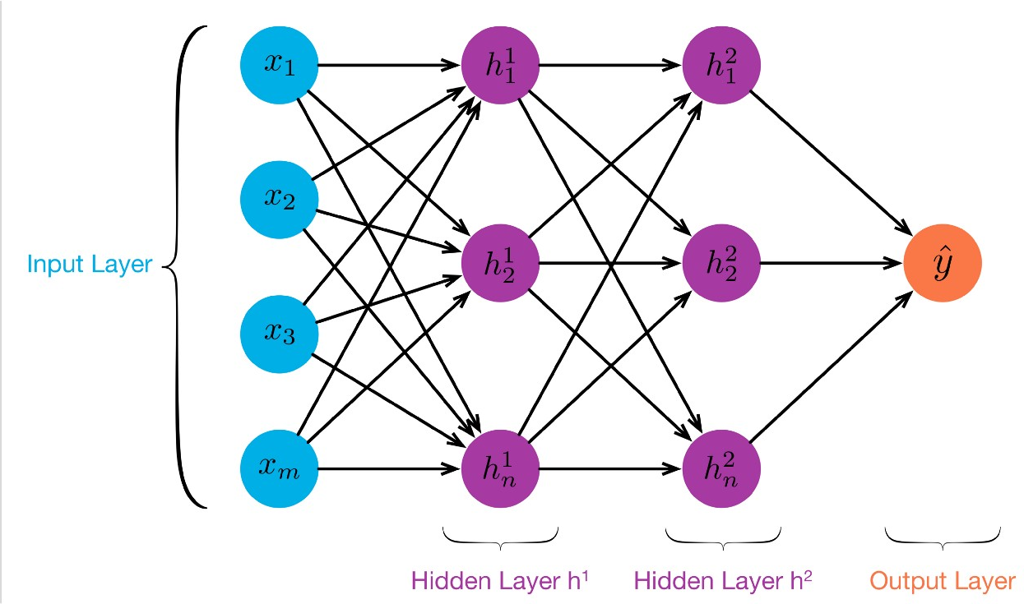
Jargon
There are m features in the input layer denoted as x₁ .. x_{m}
There are 2 “Hidden Layers” with n “neurons” each
Y is our final prediction
Notes:
M features from

Slide 20
Training the first layer
First step is to compute our weights like we’ve done in the past:
Start with random initial weights
Compute the dot product and pass through activation function to get a prediction
Compute the derivative of the activation w.r.t. the weights update

Slide 21
Training the Hidden Layer
There are n hidden units, so to train them we’ll need n weights
To get those weights, we treat the output of the input layer as our set of new features
These new inputs potentially look nothing like our actual input dataset

Slide 22
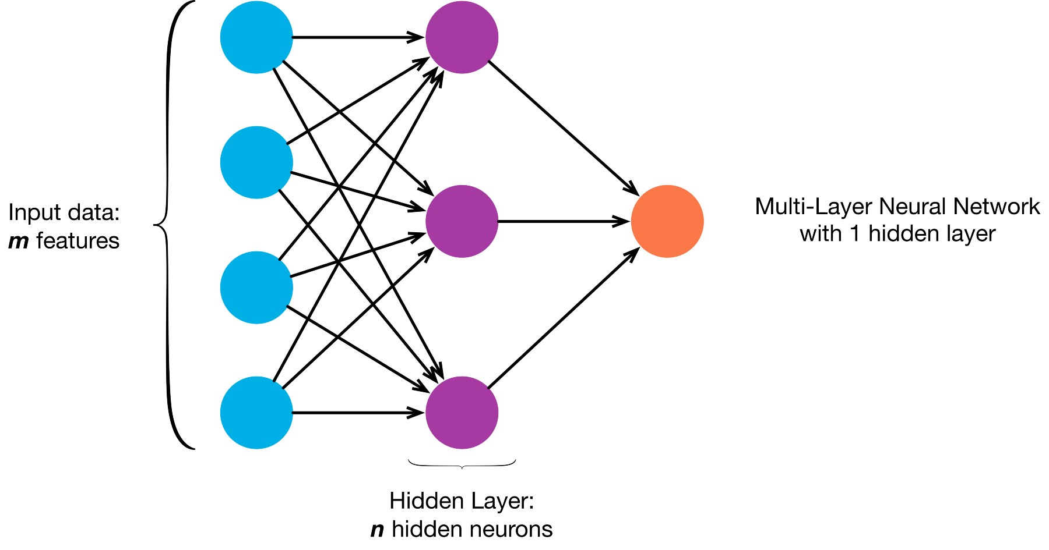

Slide 23
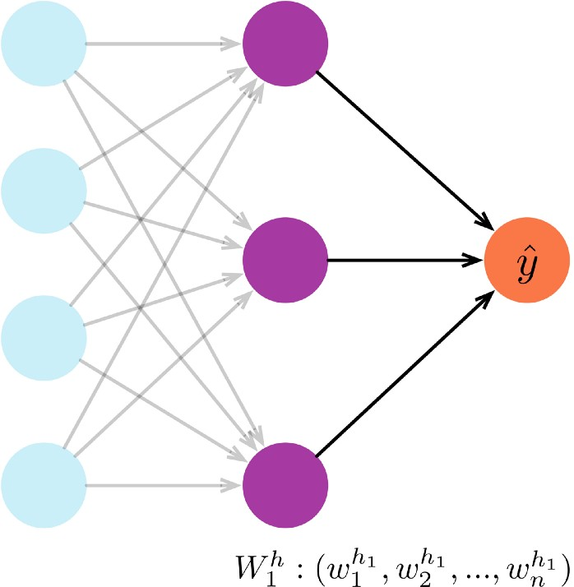
Computing the output
We finally compute our prediction as the dot product of the initial weights of the hidden layer, and the outputs from the preceding layer.

Slide 24
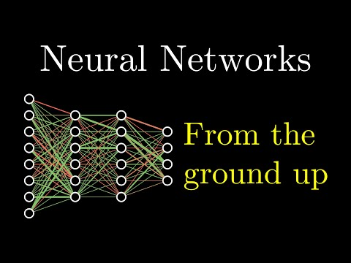
Visual
8:42

Slide 25
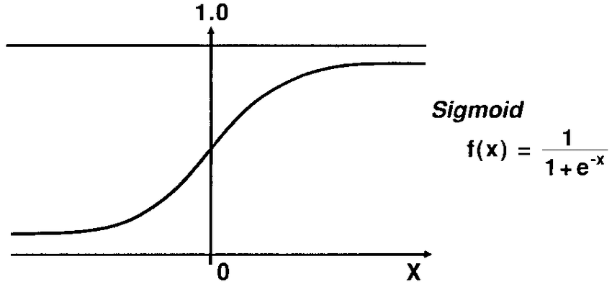
Activation
Measure of how positive the relevant weighted sum is
Y = σ(xw + b)

Slide 26
Applications
Neural nets allow us to model more complex data
More complex architectures help us remove variance that would be impossible to remove in a linear model
Ideas?

Slide 27
Backpropagation
ACM AI
Adapted from Dustin Stansbury's Blog:
https://theclevermachine.wordpress.com/2014/09/06/derivation-error-backpropagation-gradient-descent-for-neural-networks/

Slide 28
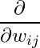
What is backpropagation?
ACM AI
“The backward propagation of errors”
Gradient descent for neural networks!
Same idea: we want to minimize cost function
To perform backpropagation, we need to take the partial derivatives of the cost with respect to the weights:

Slide 29
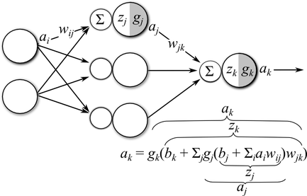
Notation
a = g(z)
z= sum(w*a)

Slide 30
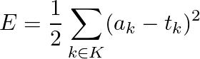
Error / Loss Function
Squared Difference

Slide 31
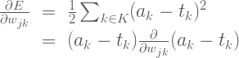
1. Output Layer Gradient (for Weights)

Slide 32
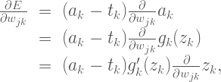
1. Partial Derivative Continued

Slide 33
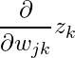
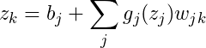
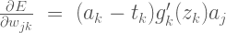
1. Partial Derivative Continued

Slide 34
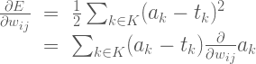
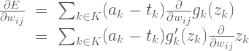
2. Hidden Layer Gradient (for Weights)

Slide 35
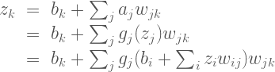
Z_k's dependence on w_ij

Slide 36
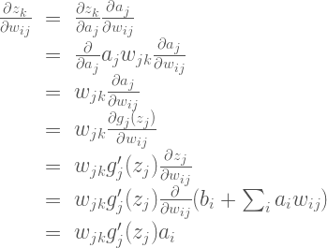
Finding the Partial Derivative of z_k

Slide 37
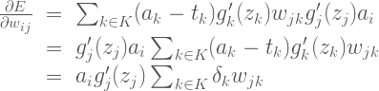
Substitute Back

Slide 38
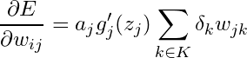
Update the Weights
Adjust the current weights:
Learning rate

Slide 39
5. Jumping Into the Code
ACM AI

Slide 40
How to Follow along
ACM AI
First, to get the program skeleton we’ve created, clone/download our Github repo: https://github.com/uclaacmai/advanced-track-fall19
You’ll have to unzip the file you get if you’re downloading
Navigate to the workshop-2-neural-nets folder.
You’ll find Two Layer Neural Network Implementation.ipynb, which is the notebook we’ll be using.

Slide 41
How to Follow along (contd.)
ACM AI
You’ll need to download a few dependencies
Follow the readme on our Github
You’ll only need NumPy and MatPlotLib

Slide 42
Feedback Form
ACM AI
Notes:
Need to create form

Slide 43
Thank you all for coming!
Next week: CNNs
Join our Facebook group
ACM AI

